Slide 1
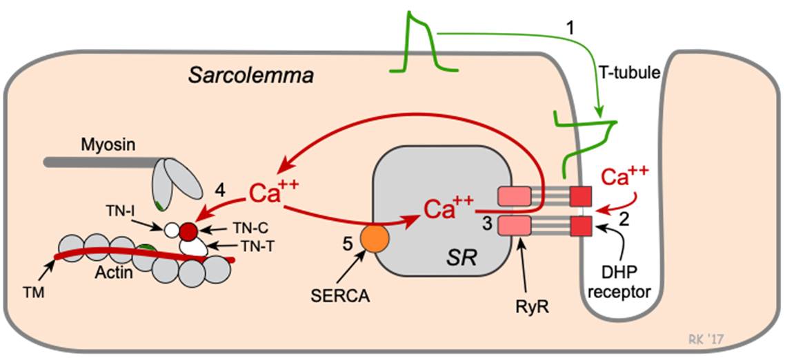
Al-ayen Iraqi university
College of Heaith &Medical Technology
Department of Anasthesia
Contractile cardiomyocytes &
excitation-contraction coupling
Lecture (2)theoretical
Applied physiology
By : MSC Khitam AL-mohammed

Slide 2
Contractile cardiomyocytes and excitation-contraction coupling
Muscle fibers: Microscopic Anatomy
The sarcolemma: is the plasma membrane of a muscle cell.
Transverse (T) tubules: Thousands of tiny invaginations of the sarcolemma. are filled with interstitial fluid.
The sarcoplasm: is the cytoplasm of a muscle fiber.

Slide 3
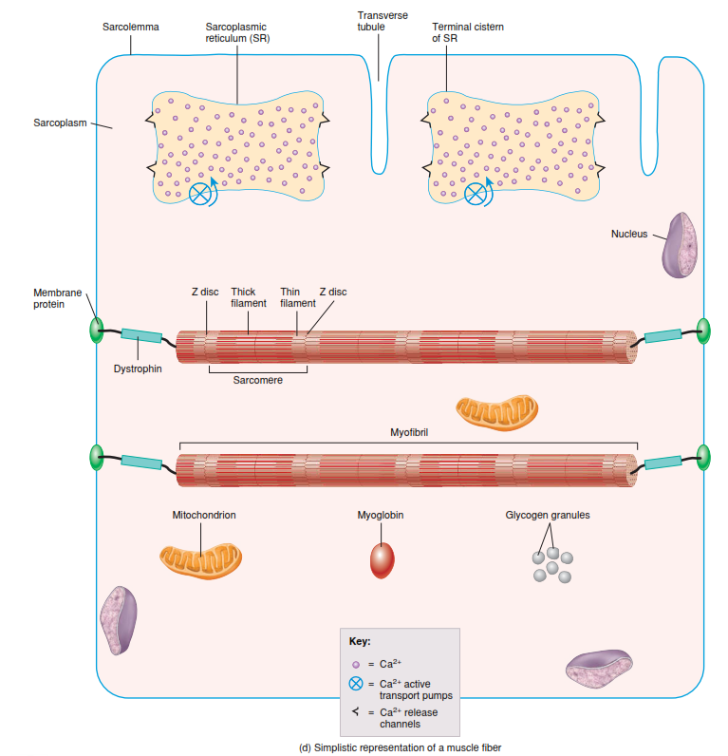
Contractile cardiomyocytes and excitation-contraction coupling
Muscle fibers: Microscopic Anatomy
Myofibrils: are the contractile organelles of skeletal muscle
Sarcoplasmic Reticulum: A sacs filled of fluid encircles each myofibril.
In a relaxed muscle fiber, the sarcoplasmic reticulum stores calcium ions
The Release of Ca 2+ from the sarcoplasmic reticulum triggers muscle contraction.

Slide 4
myofibril

Slide 5
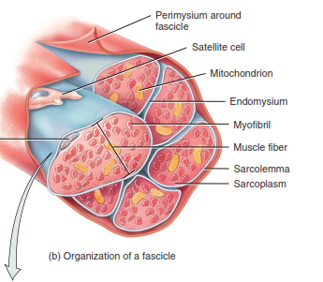
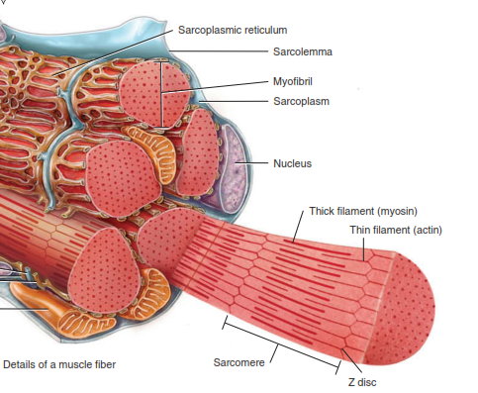
Contractile cardiomyocytes and excitation-contraction coupling
Muscle fibers: Microscopic Anatomy
Sarcomere: The filaments inside a myofibril are arranged in compartments called sarcomeres
Filaments: Within myofibrils are smaller protein structures called filaments (protein actin or protein myosin).

Slide 6
We Start here

Slide 7
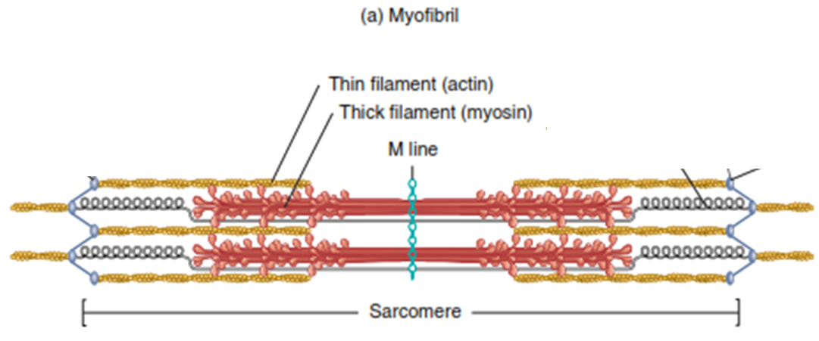
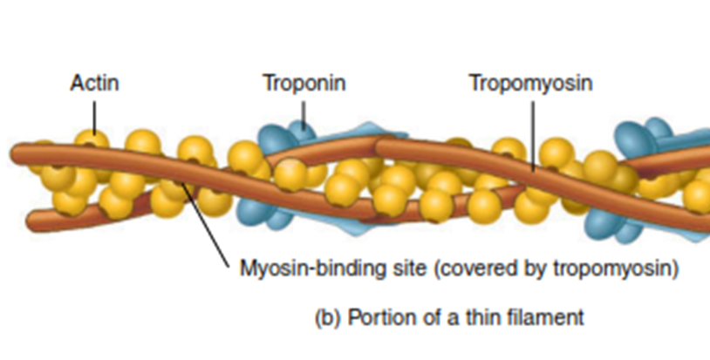
Contractile cardiomyocytes and excitation-contraction coupling
Muscle fibers: Microscopic Anatomy
Contractile proteins:
myosin
actin
Regulatory proteins:
tropomyosin
troponin

Slide 8
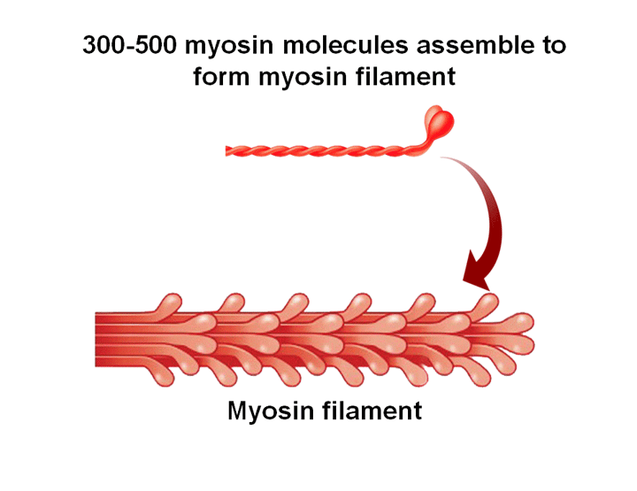
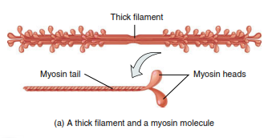
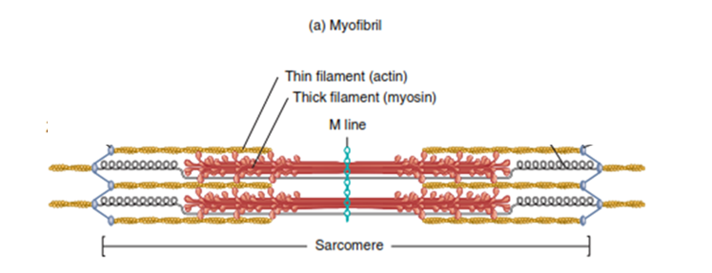
Contractile cardiomyocytes and excitation-contraction coupling
Muscle fibers: Microscopic Anatomy
Myosin:
functions as a motor protein which pull various cellular structures to achieve movement
The myosin tail points toward the center of the sarcomere.
The two myosin heads project outward and extending toward the surrounding filaments which contain Actin.

Slide 9
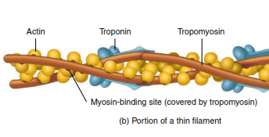
Contractile cardiomyocytes and excitation-contraction coupling
Muscle fibers: Microscopic Anatomy
Actin
actin molecules join to form an actin filament that is twisted into a helix
On each actin molecule is a myosin-binding site, where a myosin head can attach

Slide 10
Contractile cardiomyocytes and excitation-contraction coupling
Muscle fibers: Microscopic Anatomy
Tropomyosin and troponin
In relaxed muscle, myosin is blocked from binding to actin because strands of tropomyosin cover the myosin-binding sites on actin
The tropomyosin strands in turn are held in place by troponin molecules
when calcium ions (Ca²⁺) bind to troponin, troponin undergoes a change in shape
Then tropomyosin away from myosin-binding sites on actin and muscle contraction subsequently begins as myosin binds to actin
Ca2+

Slide 11
Contractile cardiomyocytes and excitation-contraction coupling
Definition of excitation-contraction coupling (ECC)
Cardiac Excitation-Contraction Coupling describes the molecular mechanisms by which the cardiac action potential initiates physical contraction of the cardiomyocyte.
Excitation-Contraction Coupling within Cardiomyocytes is largely similar to that observed in Skeletal Muscle with some important differences

Slide 12
Contractile cardiomyocytes and excitation-contraction coupling
Calcium-Induced Calcium Release (1)
Action potentials traveling along the sarcolemma and down into the transverse tubule (T-tubule) system depolarize the cell membrane.
Voltage-sensitive dihydropyridine (DHP) receptors (L-type calcium channels) open to permit calcium entry into the cell during phase 2 of the action potential.
Calcium influx triggers a subsequent release of calcium that is stored in the sarcoplasmic reticulum (SR) through calcium-release channels ("ryanodine receptors") RYR2,
and increasing intracellular calcium concentration from about 10-7 to 10-5 M.

Slide 13
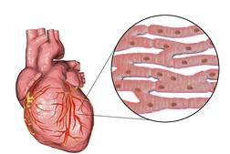
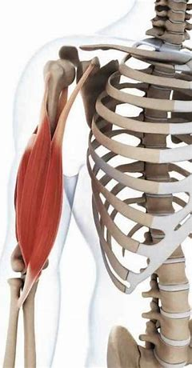
Contractile cardiomyocytes and excitation-contraction coupling
Calcium-Induced Calcium Release (2)
unlike skeletal muscle myocytes, the sarcoplasmic reticulum of cardiomyocytes is not very extensive and does not provide a sufficient store of calcium ions.
Instead, a sizable proportion of calcium enters the cardiomyocytes through L-type calcium channels on the cardiomyocyte membrane during the unique, Plateau Phase of the cardiac action potential.
Consequently, a critical portion of calcium entering cardiomyocytes following depolarization is derived from an extracellular source.
Ca2+ open

Slide 14
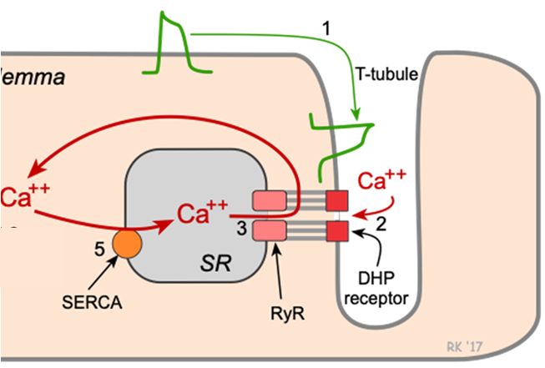
Contractile cardiomyocytes and excitation-contraction coupling
Excitation–Contraction Coupling (1)
An increase in Ca²⁺ concentration in the sarcoplasm starts muscle contraction
2. When a muscle fiber is relaxed, the concentration of Ca²⁺ in its sarcoplasm is low
3. a huge amount of Ca²⁺ is stored inside the sarcoplasmic reticulum
4. As a muscle action potential propagates along the sarcolemma and into the T tubules, it causes Ca2+ release channels in the SR membrane to open.

Slide 15
Contractile cardiomyocytes and excitation-contraction coupling
Excitation–Contraction Coupling (2)
5. When these channels open, Ca²⁺ flows out of the SR into the sarcoplasm around the thick and thin filaments. Then, the Ca²⁺ concentration in the sarcoplasm rises.
6. The released calcium ions combine with troponin, causing it to change shape.
7.This conformational change moves tropomyosin away from the myosin-binding sites on actin.
8. Once these binding sites are free, myosin heads bind to them to form cross-bridges and the contraction cycle begins.

Slide 16
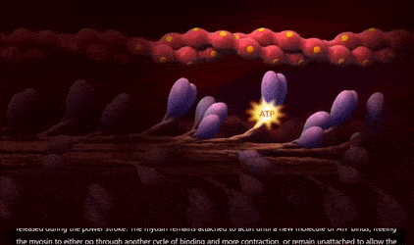
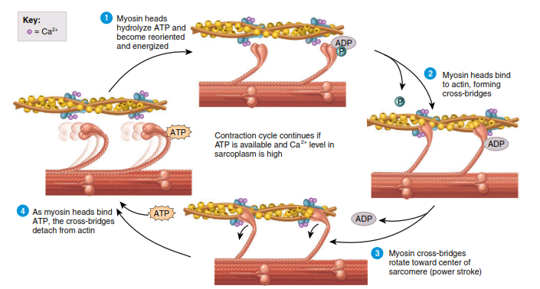
Contractile cardiomyocytes and excitation-contraction coupling
Mechanism of contraction
The Contraction Cycle: 4 steps
ATP hydrolysis. The myosin head hydrolyzes ATP
Attachment of myosin to actin to form cross-bridges.
Power stroke: the cross-bridge open and rotates toward the center of the sarcomere, sliding the actin filament to the center.
Detachment of myosin from actin.

Slide 17
Contractile cardiomyocytes and excitation-contraction coupling

Slide 18
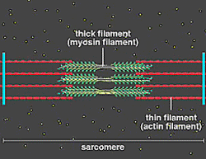
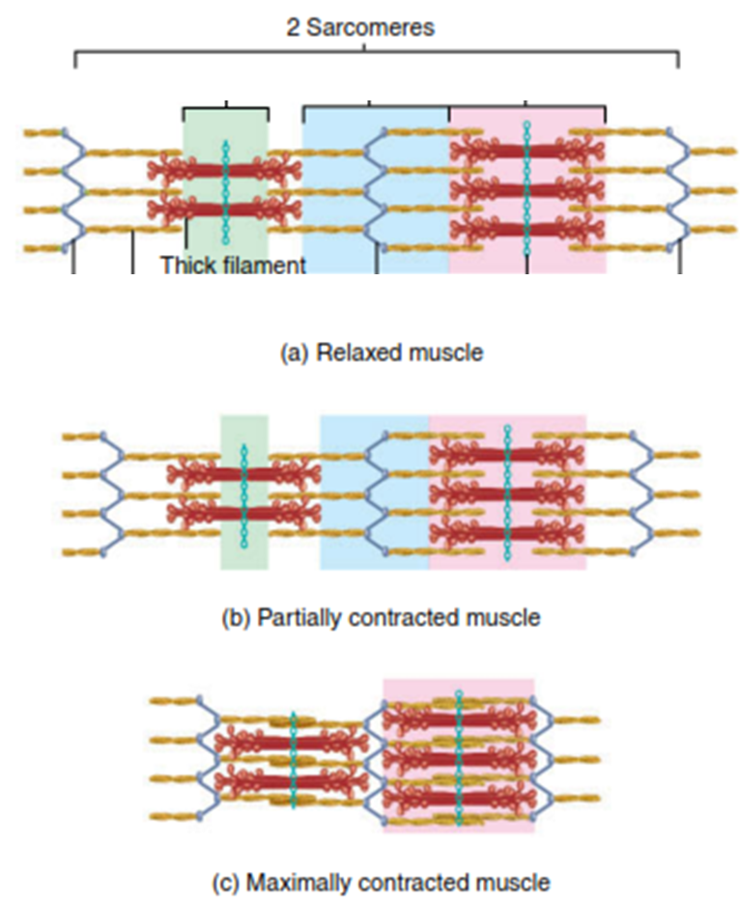
Contractile cardiomyocytes and excitation-contraction coupling
Muscle contraction
Muscle contraction occurs because myosin heads attach to and “walk” along the actin filaments at both ends of a sarcomere, progressively pulling the actin filaments toward the M line.
As a result, the sarcomere shortens.
Shortening of the sarcomeres causes shortening of the whole muscle fiber,
which in turn leads to shortening of the entire muscle.

