Slide 1
LUNG MECHANICS
Al-ayen Iraqi university
College of Heaith &Medical Technology
Department of Anasthesia
BY
Msc \ KHITAM ALMOHAMMED

Slide 2
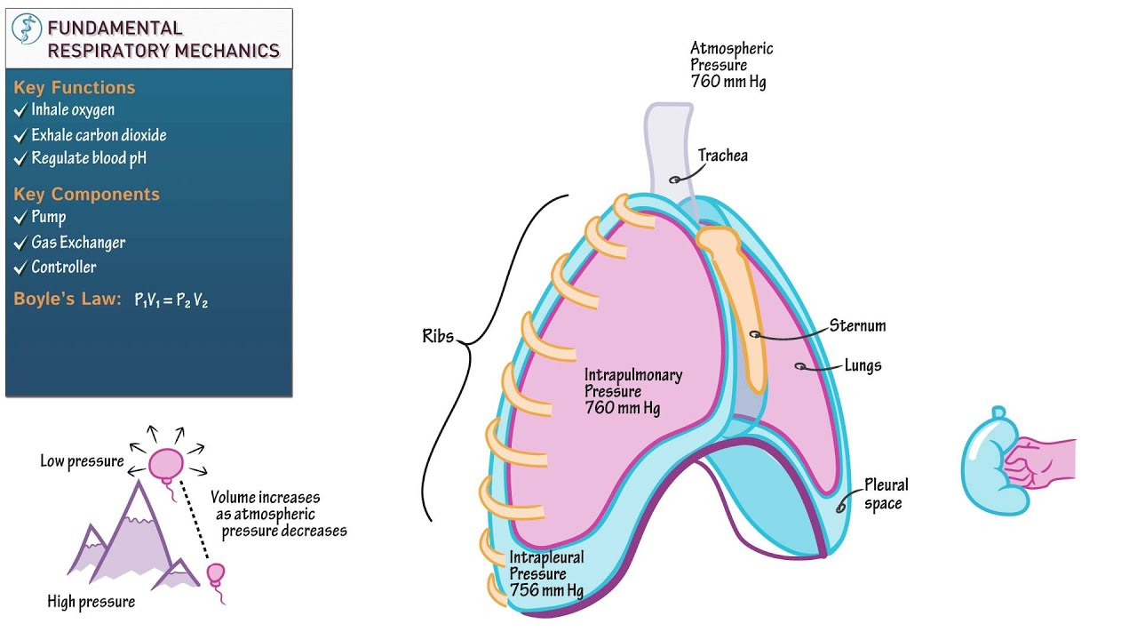
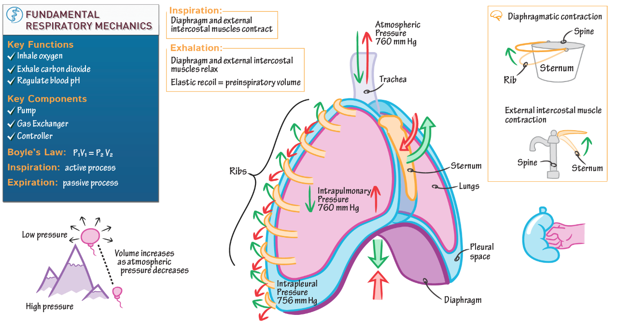
Respiratory mechanics
refers to the expression of lung function through measures of pressure and flow. From these measurements, a variety of derived indices can be determined, such as volume, compliance, resistance, and work of breathing. Plateau pressure is a measure of end-inspiratory distending pressure.

Slide 3
these measurements, a variety of derived indices can be determined, such as volume, compliance, resistance, and work of breathing (WOB). Waveforms are derived when one of the parameters of respiratory mechanics is plotted as a function of time or as a function of one of the other parameters. This produces scalar tracings of pressure-time, flow-time, and volume-time graphics, as well as flow-volume and pressure-volume (P-V) loops.

Slide 4
All current-generation positive-pressure ventilators provide some monitoring of pulmonary mechanics and graphics in real time at the bedside. When interpreting these measurements, it is important to remember that bedside monitoring of mechanics and graphics during positive-pressure ventilation portrays the lungs as a single compartment and assumes a linear response over the range of tidal volume (VT).

Slide 5
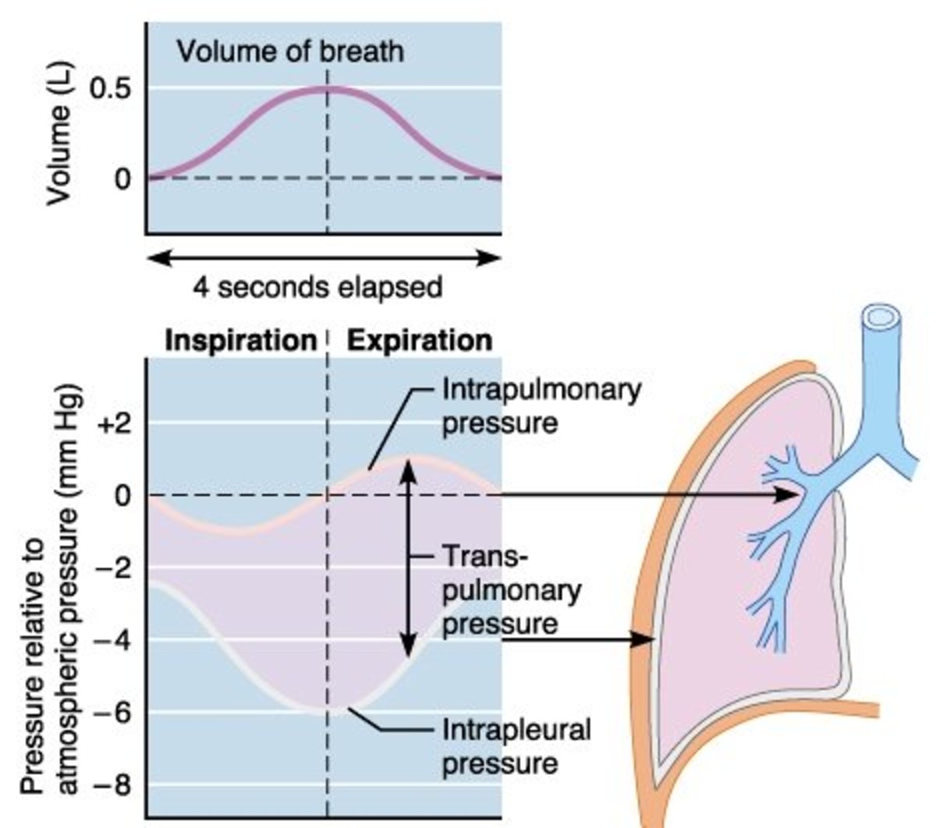
Although this is a physiologic oversimplification, the information nonetheless is useful to evaluate lung function, assess response to therapy, and optimize mechanical ventilator support. An evaluation of respiratory mechanics allows the best available evidence to be individualized to the patient. By necessity, any discussion of respiratory mechanics involves mathematics

Slide 6
Pressure
Airway Pressure
Airway pressure is measured universally during mechanical ventilation. Pressure is measured ideally at the proximal airway, but most ventilators do not because proximal airway pressure monitoring exposes the sensor to secretions and carries other technical issues.3 Alternatively, the ventilator can measure pressure proximal to the expiratory valve during the inspiratory phase to approximate inspiratory proximal airway pressure,

Slide 7
and it can measure pressure distal to the inspiratory valve during the expiratory phase to approximate expiratory proximal airway pressure. Because flow in the expiratory limb is zero during the inspiratory phase and flow in the inspiratory limb is zero during the expiratory phase, pressures measured in this manner should approximate proximal airway pressure.
Airway pressure is typically displayed on the ventilator screen as a function of time. The shape of the airway pressure waveform is determined by flow and VT from the ventilator, lung mechanics, and any active breathing efforts of the patient.

Slide 8
Alveolar Pressure
During volume control ventilation, alveolar pressure (Palv) at any time during inspiration is determined by the volume delivered and CRS: Palv = V/CRS + PEEP. For pressure control ventilation, Palv at any time after the initiation of inspiration is: Palv = ΔP × (1 − e−t/τ) + PEEP, where ΔP is the pressure applied to the airway above PEEP, e is the base of the natural logarithm, t is the elapsed time after initiation of the inspiratory phase, and τ is the time constant.

Slide 9
Plateau Pressure
Due to Raw, proximal airway pressure will always be greater than Palv during inspiration if flow is present. Palv is estimated with an end-inspiratory hold maneuver. Plateau pressure (Pplat) is measured during mechanical ventilation by applying an end-inspiratory breath-hold for 0.5–2 s, during which pressure equilibrates throughout the system, so the pressure measured at the proximal airway approximates the Palv (Fig. 1).

Slide 10
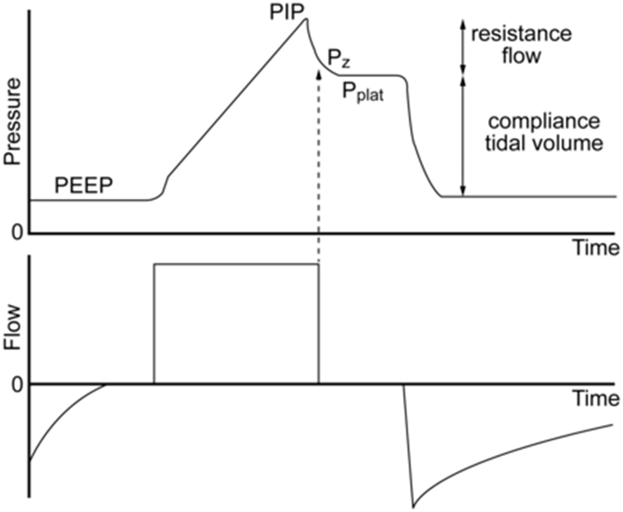

Slide 11
Airway pressure and flow waveforms during constant flow volume control ventilation, illustrating the effect of an end-inspiratory breath-hold. With a period of no flow, the pressure equilibrates to the plateau pressure (Pplat). Pplat represents the peak alveolar pressure. The difference between Pz and Pplat is due to time constant inhomogeneity within the lungs. The difference between the peak inspiratory pressure (PIP) and Pplat is determined by resistance and flow. The difference between Pplat and PEEP is determined by tidal volume and respiratory system compliance. Pz = pressure at zero flow.

Slide 12
A method has been described that uses the expiratory time constant (τE) to provide real-time determinations of Pplat without the need for an end-inspiratory pause maneuver.8 Using this approach, τE is estimated from the slope of the passive expiratory flow curve between 0.1 and 0.5 s. Pplat is then calculated as: (2)This approach has the advantage of being able to be used in spontaneous breathing modes such as pressure support, but has the disadvantage of requiring a computerized algorithm to make the necessary calculations.

Slide 13
Auto-PEEP
Incomplete emptying of the lungs occurs if the expiratory phase is terminated prematurely. The pressure produced by this trapped gas is called auto-PEEP, intrinsic PEEP, or occult PEEP. Auto-PEEP increases end-expiratory lung volume and thus causes dynamic hyperinflation.9,10
Auto-PEEP is measured by applying an end-expiratory pause for 0.5–2 s The pressure measured at the end of this maneuver in excess of the PEEP set on the ventilator is defined as auto-PEEP. For a valid measurement, the patient must be relaxed and breathing in synchrony with the ventilator, as active breathing invalidates the measurement. The end-expiratory pause method can underestimate auto-PEEP when some airways close during exhalation, as may occur during ventilation of the lungs of patients with severe asthma. In spontaneously breathing patients, measurement of esophageal pressure (Pes) can be used to determine auto-PEEP

Slide 14
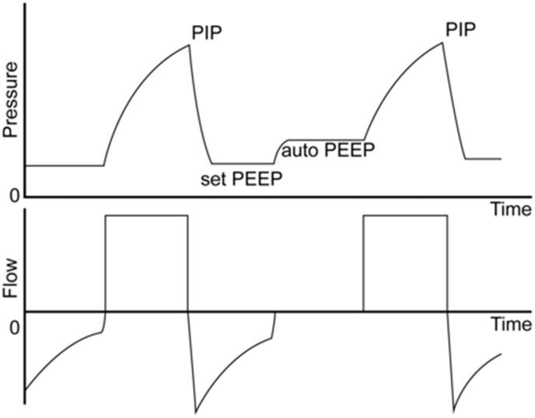
Applying an end-expiratory breath-hold allows measurement of end-expiratory alveolar pressure. The difference between PEEP set and the pressure measured during this maneuver is the amount of auto-PEEP. PIP = peak inspiratory pressure.

Slide 15
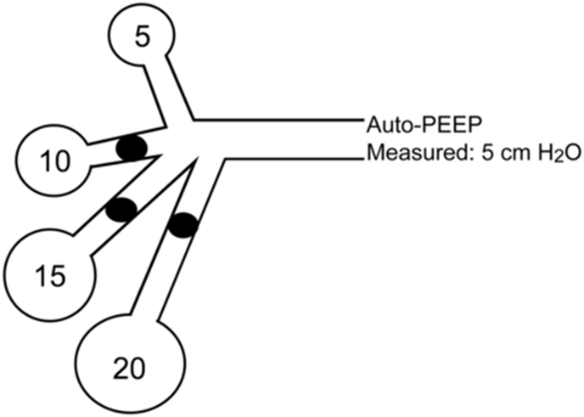
As illustrated here, the measured auto-PEEP can be considerably less than the auto-PEEP in some lung regions if airways collapse during exhalation.

Slide 16
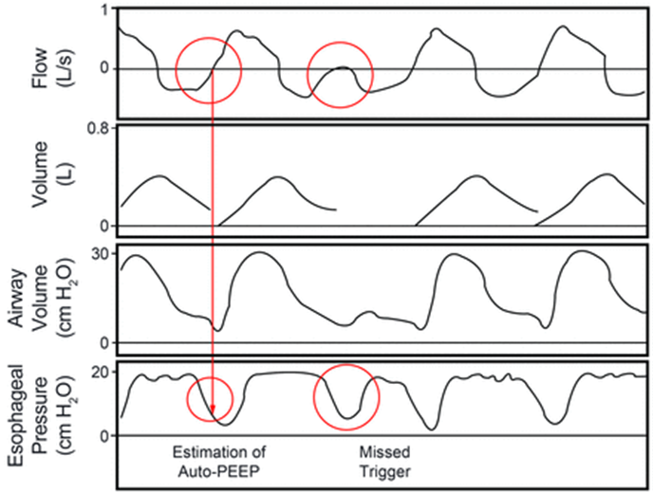
Airway pressure, flow, volume, and esophageal pressure (Pes) waveforms in a patient with auto-PEEP. Note the decrease in Pes required to trigger the ventilator, which represents the amount of auto-PEEP. Also note that flow does not return to zero at the end of exhalation, and the inspiratory effort does not trigger the ventilator.

Slide 17
Auto-PEEP is a function of ventilator settings (VT and expiratory time [TE]) and lung function (Raw and lung compliance [CL]): auto-PEEP = VT/(CRS × (eKx × TE − 1), where Kx is the inverse of the τE (1/τ). Note that auto-PEEP is increased with increased resistance and compliance, increased breathing frequency or increased inspiratory time (TI; both decrease TE), and increased VT. Clinically, auto-PEEP can be decreased by decreasing minute ventilation (rate or VT), increasing TE (decreasing rate or TI), or decreasing Raw (eg, bronchodilator administration).

Slide 18
Mean Airway Pressure
Mean airway pressure (P̄aw) is determined by PIP, the fraction of time devoted to the inspiratory phase (TI/Ttot, where Ttot is total respiratory cycle time), and PEEP. For constant flow-volume ventilation, in which the airway pressure waveform is triangular, P̄aw can be calculated as: P̄aw = 0.5 × (PIP − PEEP) × (TI/Ttot) + PEEP. During pressure ventilation, in which the airway pressure waveform is rectangular, P̄aw can be estimated as: P̄aw = (PIP − PEEP) × (TI/Ttot) + PEEP. The mean Palv may be different than P̄aw if the inspiratory airway resistance (RI) and expiratory airway resistance (RE) are different, which is often the case in lung disease: mean Palv = P̄aw + (V̇E/60) × (RE − RI), where V̇E is expiratory flow.

