Slide 1
Lecture :1
An introduction for general geology by
Dr. Murtadha Al-Ziadi

Slide 2
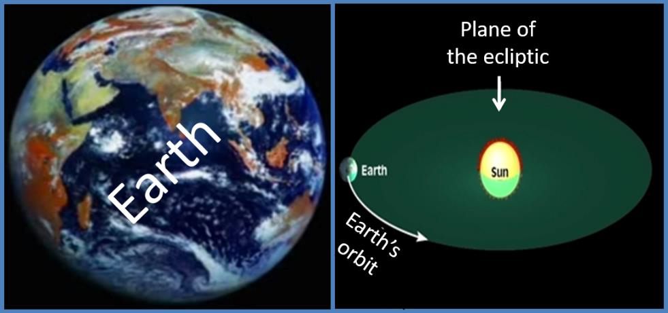
What is Geology?
It is a science that looks at the earth and it's covers, in terms of the composition and the factors affecting them and their history.

Slide 3
The importance of geology:
1- Disclosuring of sources of energy such as oil, natural gas and minerals.
2- Determining the appropriate places for construction of dams , bridges and other
Construction projects .
3- Prospecting for natural mineral resources such as gold, silver, copper, lead, iron, aluminum, nickel, phosphate and halite.
4- Relocating the raw materials for construction such as sand, gravel, limestone, marble and chemical industries, such as sulfur, calcium, sodium and chlorine, which are used in the manufacture of drugs and pesticides and fertilizers.
5- The large increase in the number of the population, especially in the arid and desert areas has led to the search for other sources such as under groundwater.
6- The possibility of the cause of the occurrence of natural disasters such as volcanoes, earthquakes and floods, as well as the prevention of landslides and buildings cracked.
7- Identifying natural barriers as well as the best ways to move soldiers and military vehicles and identify suitable sites for digging trenches and building military bases.

Slide 4
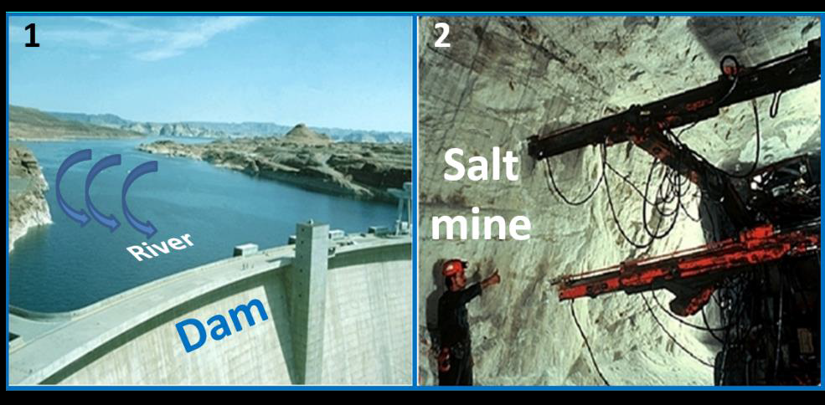

Slide 5
The most important branches of the geology:
1- Crystallography:
Looks at the crystallization of minerals in terms of composition and chemical and physical characteristics and conditions of their existence and its benefits.
2- Mineralogy:
Specializes in the study of minerals through knowing of their natural (physical) and chemical properties, Classification and the conditions of their existence and their benefits.
3- Petrology:
Studies the rock types in terms of the origin and composition, characteristics and classification and the conditions of their existence.
4- Dynamic geology (physical):
Interested in studying the internal and external factors that lead to the formation of the natural and geological phenomena such as mountains, rocks and minerals in the earth's surface.
5-Paleontology:
Looking to find out the remnants of ancient organisms or effects of animals and plants that lived in the previous geologic time.

Slide 6
6- Historical geology:
Specializes in studying the order of rock layers from the earliest times to the present day, where studying fossils characteristics of each layer of the sequences and arrange the calendar of the land and divided into epochs and ages and times of sequential terms by which knowledge of the distribution of water and land through different of geological ages.
7- Stratigraphy:
Is the science that studies the laws and deposition conditions and places of various sedimentary rock layers, and after it is fragmentation from different rocks and transported by water and air.
8- Structural geology:
Interested in studying the current construction and evolution of the earth's crust through geological ages. It explains the scientific reasons to the configure of different geological structures such as faults, fractures and joints in the rock layers as well as the reasons for the formation of the mountains.
9- Geophysics:
An important branch in the science of earth that specializes in the study of the underground layers of different geological formations and especially private studying the invisible structures that could contain oil and mineral deposits for economic and water.

Slide 7
10- Geochemistry:
Specialized in studying of minerals and rocks by chemical means and the distribution of the constituent elements of the earth's crust, as well as determining the type and proportion of mineral ores in the earth's crust.
11 - Economic Geology:
Is an applied science concerned with the search for economic resources and identifying and evaluating the purposes of benefit.
Economic Geology includes several branches,
Some of them are:
- Petroleum Geology.
- Mining Geology. - Engineering Geology. - The geology of mineral deposits
-The geology of radioactive isotopes.
12- Hydrogeology:
Is interested in studying the sources of surface water and groundwater and the characteristics of the physical and chemical water and studing the layers of the earth containing groundwater.
13- Engineering Geology:
This includes knowledge of the mechanical and engineering properties of Earth crust and for the purpose of building bridges, dams and various facilities such as high buildings and others.

Slide 8
Relationship between geology and other Sciences:
Noting from the classification of some of the branches of Earth Science that this science develops in conjunction with other sciences such as chemistry, physics, biology, astronomy and engineering sciences .

Slide 9
Scientists have determined that earth' layers as following :
A- Crust.
B- Mantle.
C-Outer core
D-Inner core
Crust:
The outermost layer is the crust, a very thin outer skin that ranges from about 7 to more than 70 kilometers.
Earth's crust is divided into:
1- Continental crust: In most regions, the continental crust is about 35 kilometer thickness, but it may exceed 70 kilometers in areas of prominent mountains.
The continental crust consists of many types of rocks. One of the most common in the upper crust is the igneous rock granite.
2- Oceanic crust: Compared with continental crust, oceanic crust is quite thin, average only 7 kilometers in thickness.
In addition, the oceanic crust is very uniform in composition, being mainly composed of the dark igneous basalt.
On average, continental rocks are less dense (weigh less in equal amount) than oceanic rocks, which partially explains the lower position of the ocean floor compared to the continents.

Slide 10
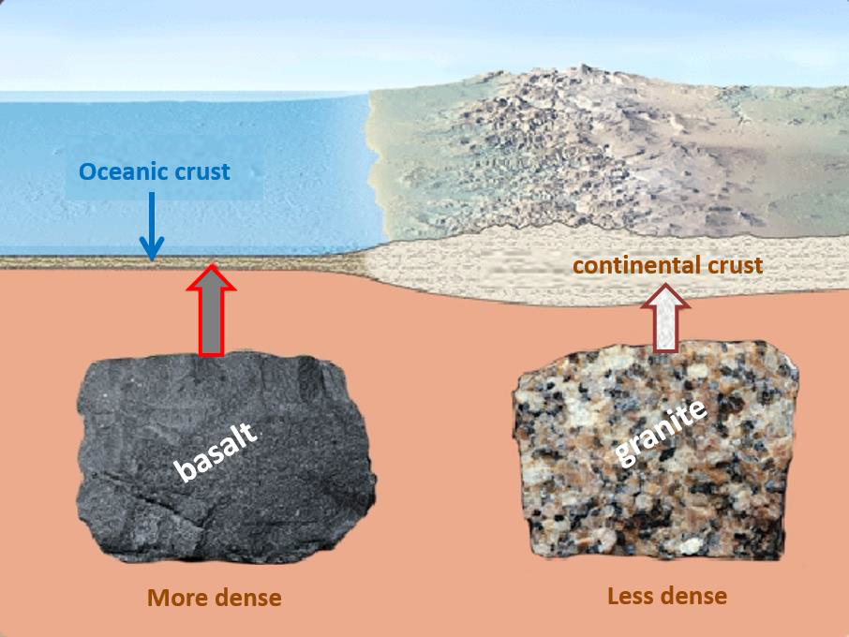

Slide 11
Mantle:
Beyond the outer core is the mantle, a solid, rocky layer having a thickness of about 2885 kilometers. Over 82 percentage of earth's volume is contained within the mantle.
The rock that makes up the mantle is composed of silicate minerals that are rich in iron and magnesium.
Outer core:
Surrounding the inner core is the outer core, a fluid, metallic layer some 2270 kilometers thick.
Earth's magnetic field is thought to be generated by vigorous churning of the iron-rich material in the hot, fluid outer core.
Inner core:
At earth's center is the inner core. It is solid, iron-rich sphere having a diameter of 2432 kilometers.

Slide 12
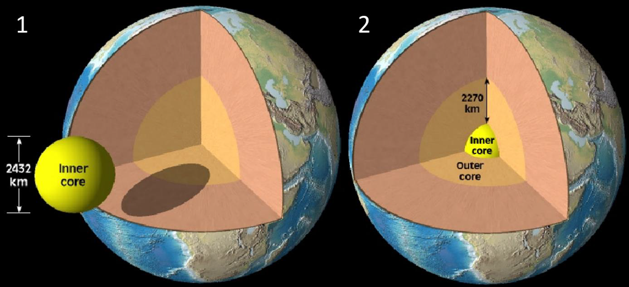

Slide 13
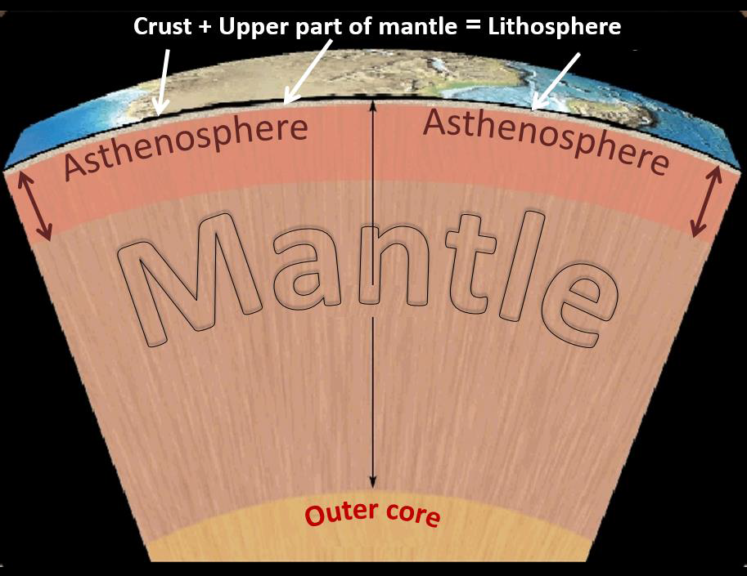
In addition to earth's four major layers, scientists have identified two other divisions of earth's interior are:
E- Asthenosphere.
F- Lithosphere.

Slide 14
Asthenosphere:
It located within the upper mantle, between the depths 100-660 kilometers and is composed of hot, rocky material that is capable of very slow movement.
Lithosphere:
Situated above the asthenosphere, called the lithosphere. It includes the uppermost mantle and overlying crust and behaves as a strong, rigid layer.
In contrast to the hot, weak zone below, the lithosphere is strong because it composed of comparatively cool rocks.
Geologists have discovered that the weak rocks within the asthenosphere allow earth's rigid outer shell (lithosphere) to move.

Slide 15
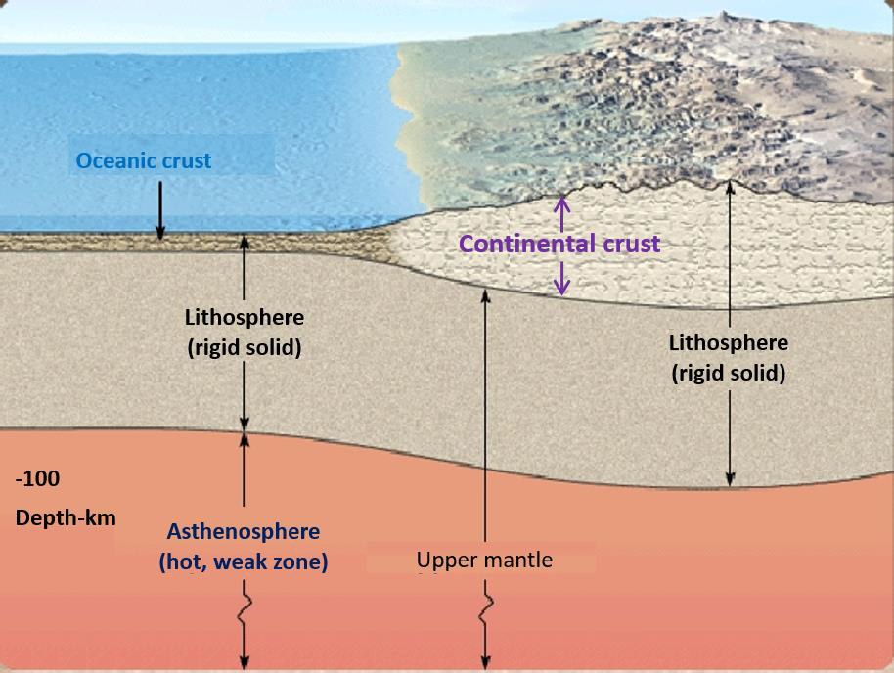

Slide 16


